Slide 1
Total Tabs Plus
2016

Slide 2
What is it, and what is its purpose?
TotalTabsPlus is an additional worksheet in IPS-generated or Researcher-generated tabs
The goal is to make it easier to identify data points that are statistically significant or insignificant, allowing researchers to uncover stronger insights in less time

Slide 3
What does it do?
Total Tabs Plus does the following:
Aggregate all of your tables into one worksheet, ordered by table number
Show statistically significant datapoints in a different text color than datapoints which are not statistically significant
Provide groupings of subgroups, as defined by your stat testing
Calculate a difference between the largest and smallest values of the subgroups being analyzed
Provide color-coding of the differences, within table
Provide a link to each table for further investigation
Allow for sorting and filtering to

Slide 4
What assumptions exist?
Assumptions
The banner is consistent across all tables
Stat testing exists
Tables include Base, Count and Frequency
Known Issues
Tables with table-stacking (not dataset stacking) will be skipped
Tables with different a different banner will be skipped
Special tables created by IPS (e.g. Reporting Tables) will be skipped
Tables with sub-based rows can cause issues

Slide 5
How to use Total Tabs Plus
When you open your tabs, there will be two new worksheets:
TotalTabsPlus
TotalTabsPlusColor

Slide 6
How to use Total Tabs Plus
When you open your tabs, there will be two new worksheets:
TotalTabsPlus
TotalTabsPlusColor
The only difference between these worksheets is whether scaled conditional formatting is applied to the “Difference” column

Slide 7
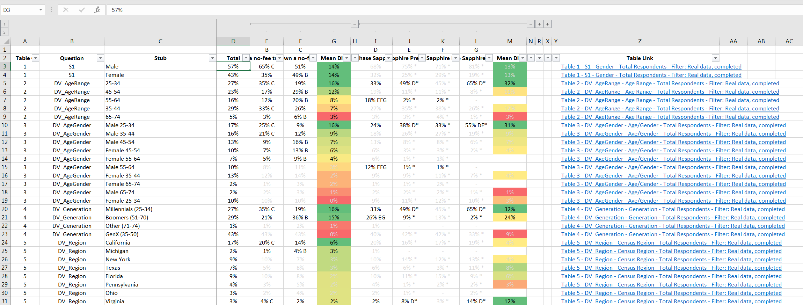
An overview of Total Tabs Plus layout
Pressing the [+] or [-] buttons will expand or collapse the subgroup columns
Question # as defined in the table name
Stub name from the table
%’s pulled in from the tables
“Difference” column: the magnitude of difference between the largest and smallest values of the stat tested group
Clickable Link which will take your to the table
Filters allow you to sort rows. You’ll also want to use the Custom Sort feature
If statistical significance is found, text is black. If no statistical significance is found, text is light grey
Conditional-formatting provides shading within table with the largest magnitude in green, and the smallest magnitude in red

Slide 8
Getting the most out of Total Tabs Plus Filtering
Pick a group to analyze, collapse the others, and filter to Color → Automatic
See next slides

Slide 9
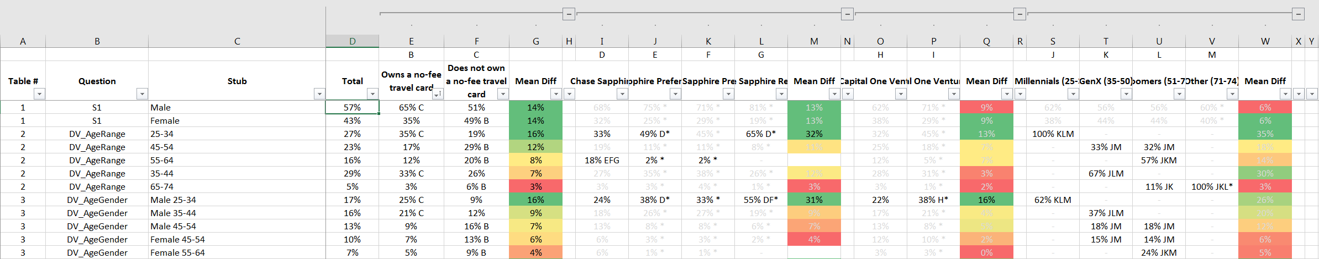
Getting the most out of Total Tabs Plus Filtering
Collapse Columns by pressing the [-]
You can expand them by the pressing [+] icon

Slide 10
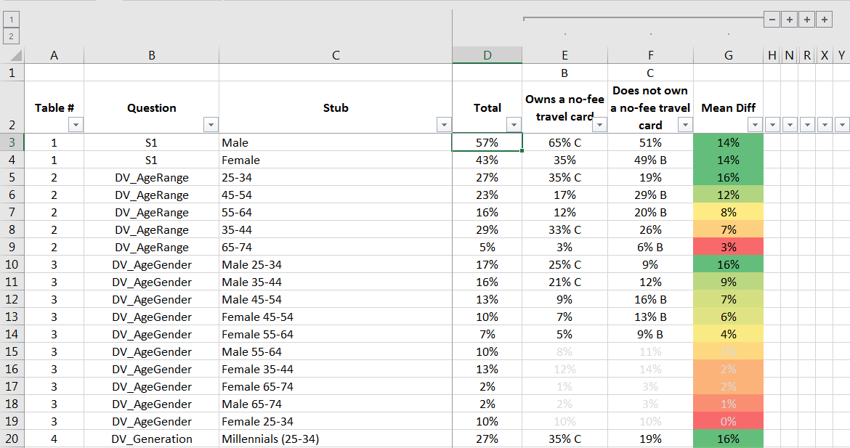
Getting the most out of Total Tabs Plus Filtering
After collapsing

Slide 11

Getting the most out of Total Tabs Plus Filtering
Apply Filter by clicking the down-arrow on any column
Filtering by color to ‘Automatic’ will show you statistically significant stubs only.
Filtering by color to light grey will show you statistically insignificant stubs only.

Slide 12
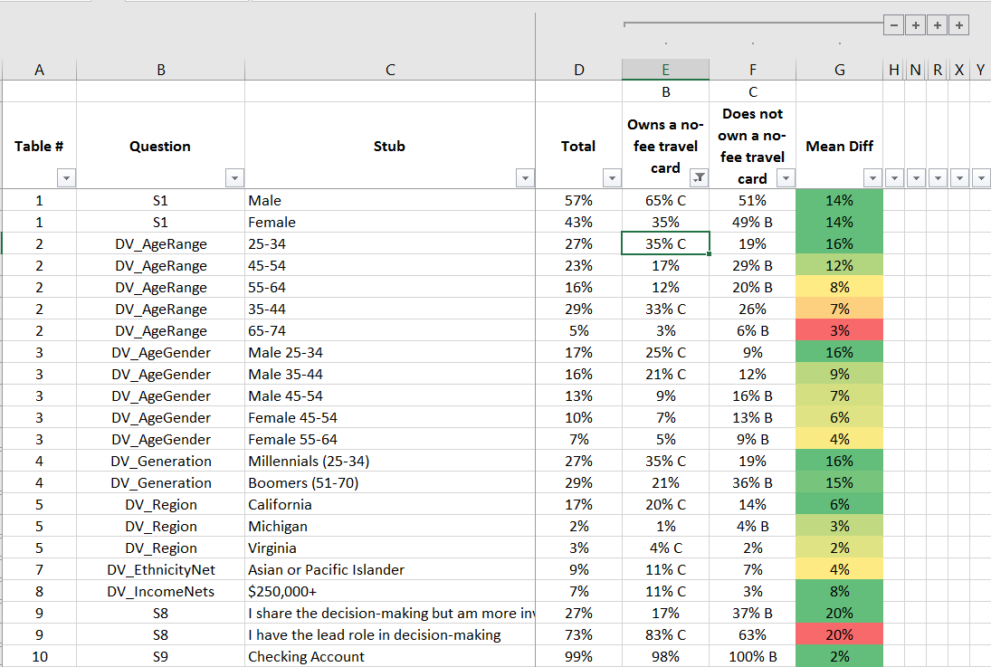
Getting the most out of Total Tabs Plus Filtering
After (only stubs with statistical significance are shown)

Slide 13

Getting the most out of Total Tabs Plus Filtering
You can clear filters easily. You can also change the color to light-grey to get insignificant stubs only

Slide 14
Getting the most out of Total Tabs Plus Custom Sorting
Custom-sorting, in combination with filtering, makes the tool even more powerful
See next slides

Slide 15
Getting the most out of Total Tabs Plus Custom Sorting
We begin with unfiltered tabs, collapsed

Slide 16
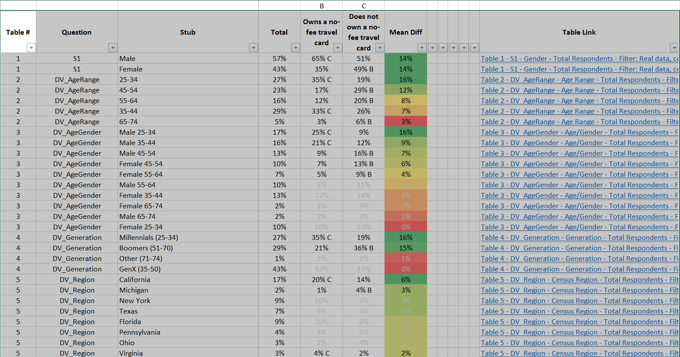
Getting the most out of Total Tabs Plus Custom Sorting
Next, we highlight all of the data, beginning in cell A2
Tip: If you press CTRL+Shift+LeftArrowKey and then CTRL+SHIFT+DownArrowKey, you can highlight things without dragging your mouse

Slide 17
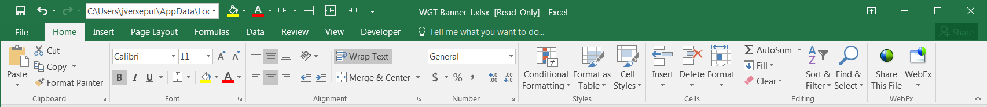

Getting the most out of Total Tabs Plus Custom Sorting
Next, click the “Sort & Filter” button in the ribbon at the top of the screen, within the Home tab
Then click on ‘Custom Sort’

Slide 18
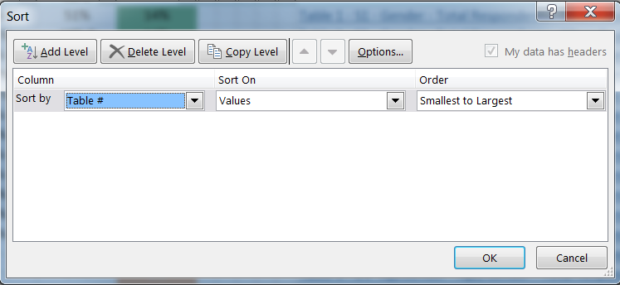

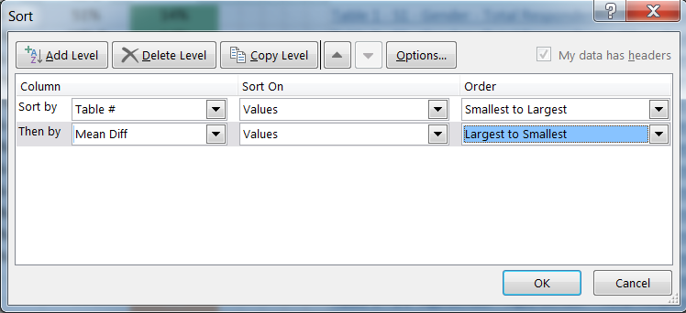
Getting the most out of Total Tabs Plus Custom Sorting
First, sort by Table # in Smallest to Largest
Then, click ‘Add Level’, and select the ‘Mean Difference’ following the subgroup you’re testing. There will be multiple, so make sure it’s specific to your group. Then, order it in Largest to Smallest.

Slide 19
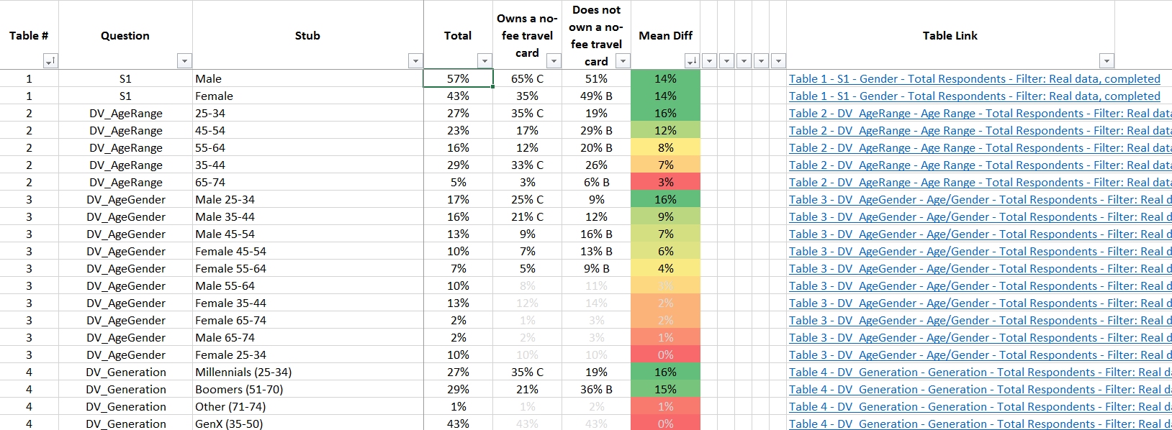
Getting the most out of Total Tabs Plus Custom Sorting
This has told Excel to sort by table # (so your tables are in order), then to sort the rows based on descending magnitude of difference between the largest and smallest values of those groups
You’ll noticed the coloring goes from green to red, within each table

Slide 20
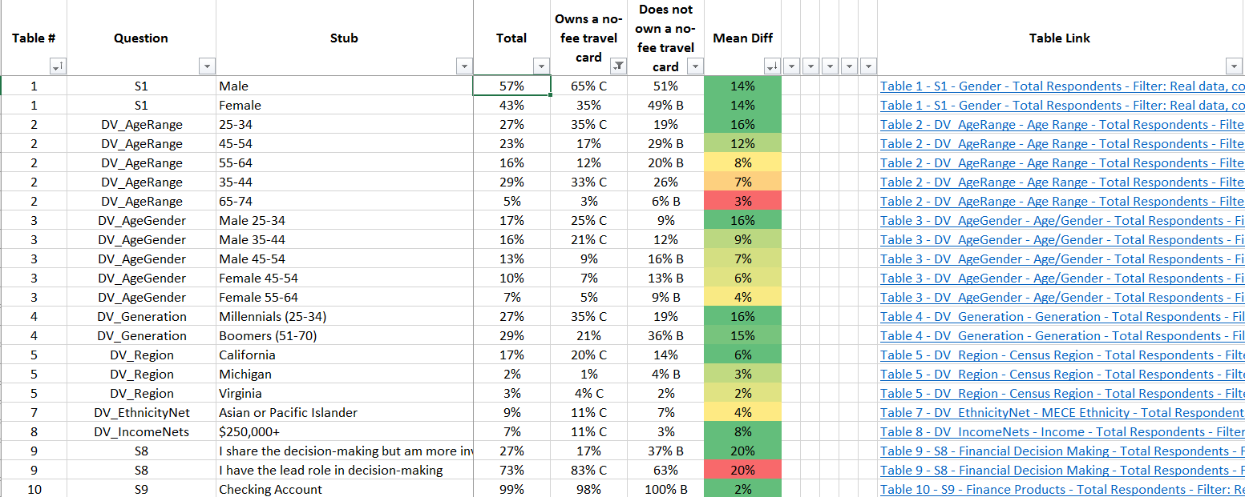
Getting the most out of Total Tabs Plus Custom Sorting
Now, apply the same filtering you applied earlier
Filter to Color → Automatic
You are now looking at statistically significant stubs only, rank-ordered in largest to smallest magnitude

Slide 21
Getting the most out of Total Tabs Plus Multi-Level Custom Sorting
If you want to show all rows that have any significance between any of the sub-groups, we can add multiple levels to our sorting
If we only apply the Custom Sort or Filtering to one of the columns, it’ll only show rows for which significance is indicated for that specific column
This would occur when you have more than 2 sub-groups being stat-tested against each other

Slide 22
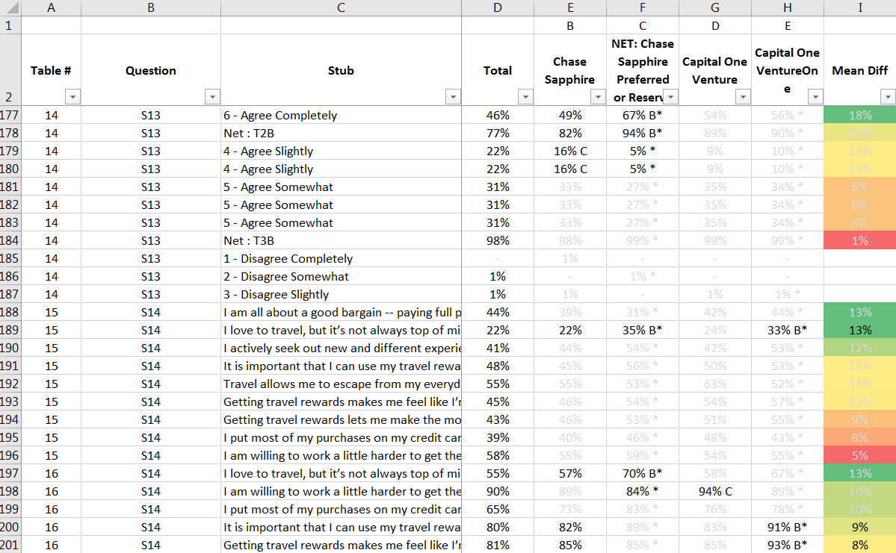
Getting the most out of Total Tabs Plus Multi-Level Custom Sorting
If you want to show all rows that have any significance between any of the sub-groups, we can add multiple levels to our sorting

Slide 23
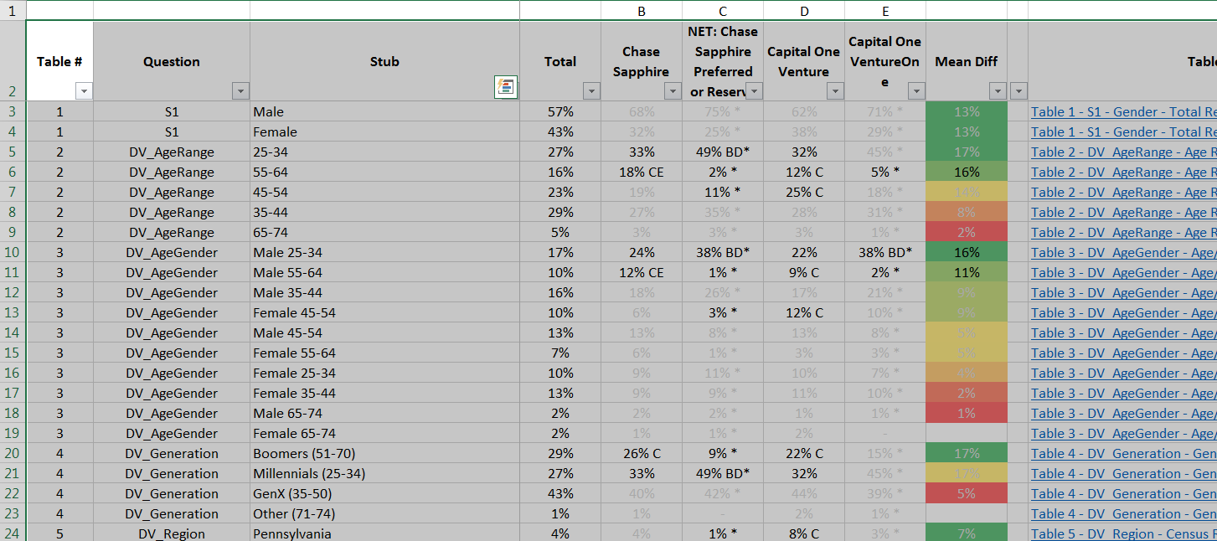
Getting the most out of Total Tabs Plus Multi-Level Custom Sorting
Begin by highlighting the data, like you did before
Then click on Custom Sort and Filter, like you did before

Slide 24
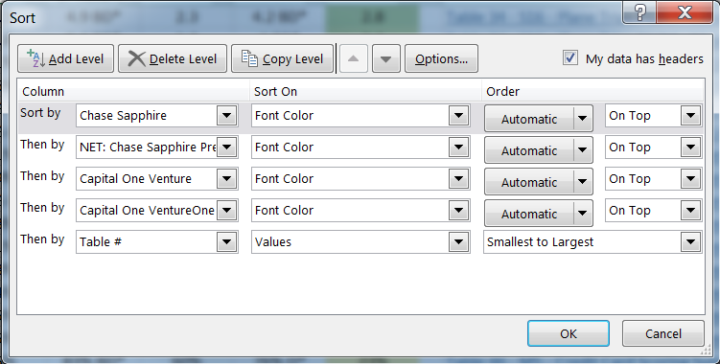
Getting the most out of Total Tabs Plus Multi-Level Custom Sorting
If you want to show all rows that have any significance between any of the sub-groups, we can add multiple levels to our sorting

Slide 25
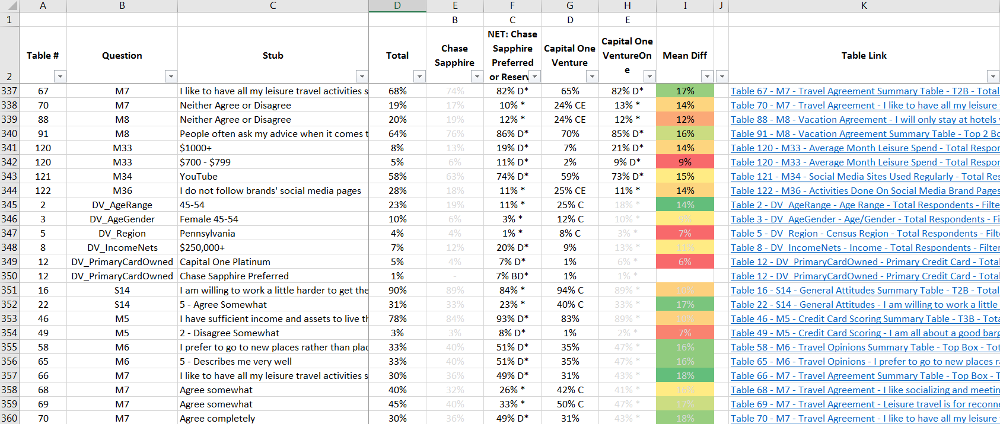
Getting the most out of Total Tabs Plus Multi-Level Custom Sorting
Now the tables will be ordered and sorted

